Slide 1
Mastering SQL Server Statistics
Uwe Ricken
https://github.com/db-berater/Mastering-SQL-Server-Statistics

Slide 2




Uwe Ricken db Berater GmbH
I am working with IT-systems since early 1990's and with the main focus on Microsoft SQL Server since version 6.0. I started with development of database applications in 1998 with a professional CRM-System based on Microsoft products (Microsoft Office and Microsoft SQL Server).
Since 2008 I'm focused exclusively on Microsoft SQL Server and working in 3rd level support teams for banks, insurances and global industries.
Since May 2013 I am a Microsoft Certified Master: SQL Server 2008 which was an amazing way into the depth of Microsoft SQL Server.
In July 2013 I have been awarded with the MVP Award for Microsoft SQL Server.
www: http://www.db-berater.de
email: uwe.ricken@db-berater.de
blog: http://www.sqlmaster.de
BlueSky: @sqlbambi

Slide 3
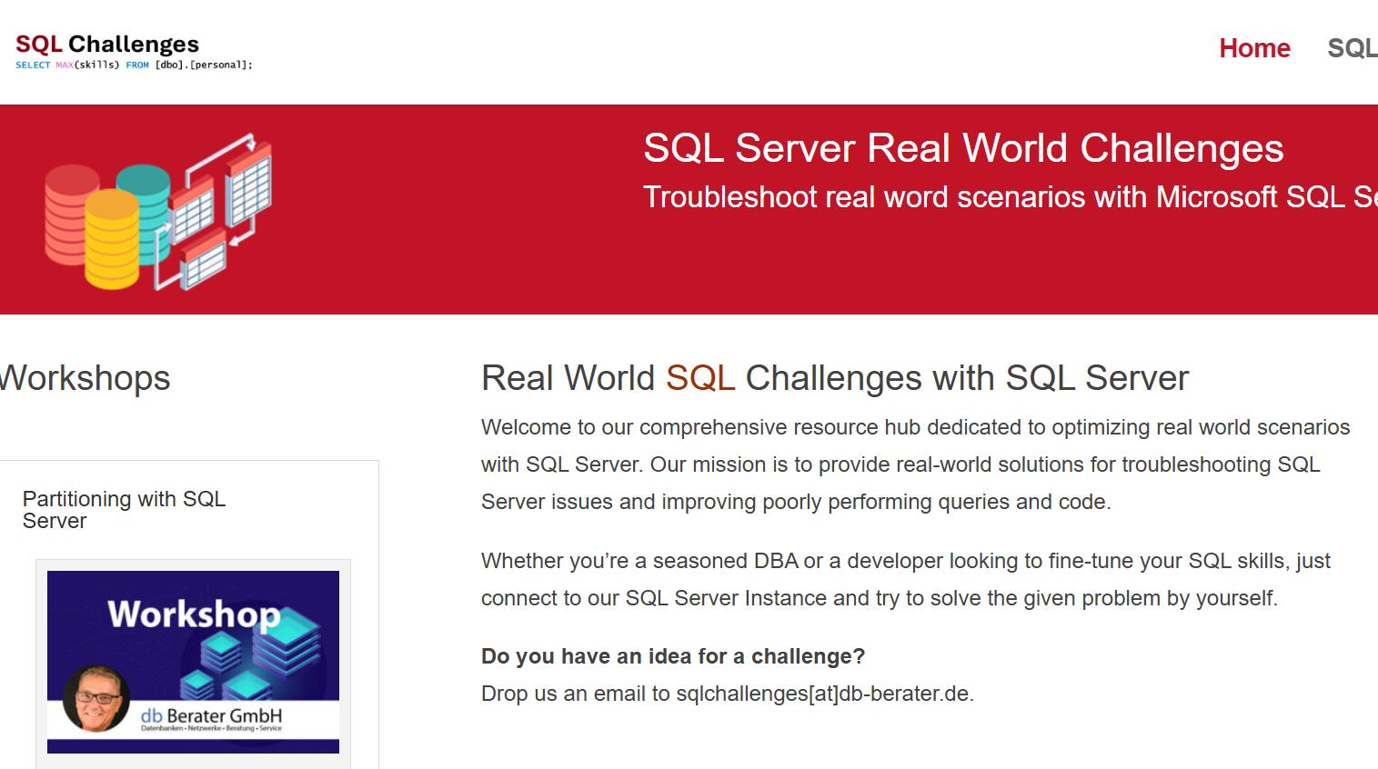
Challenge SQL Server real world scenarios
Get a challenge at least once a month
Connect to a provided SQL Server Instance
Load the challenge scenario
Try to solve it
Blog about your solution
Leave a link in the comments of the challenge to your blog post.
https://sqlchallenges.de

Slide 4
Session Agenda
Basics about Statistics
  Database settings for Statistics
  When are Statistics created?
  When are Statistics updated?
  When are Statistics deleted?
Settings for Statistics
  no_recompute
  auto_drop (>=SQL Server 2022)
Incremental Statistics
Ascending Key(s) and Statistics
Real World Scenarios and Statistics

Slide 5
What are Statistics in SQL Server
The tiny data models
that tell the optimizer
what your tables look like.

Slide 6
Let's plan a house….

Slide 7
I would like a house for my family
Parsing
  Parsing is the process in SQL Server where the query text is broken down into its grammatical components, checked for valid syntax, and prepared for further processing.
  In real life, parsing is like someone reading your sentence and first making sure the grammar makes sense before deciding what you want them to do.
Parsing
Compilation
Optimization
Query Ex…
Notes:
The first step toward a new house is finding the right partner to create the construction plans.

Slide 8
I would like a house for my family
Compilation
  Compilation is the phase in SQL Server where the validated query is transformed into a logical execution plan that describes what needs to be done, step by step, without yet deciding how it will be executed.
  In real life, compilation is like an architect taking your idea for a house and turning it into a clean, structured blueprint.
  The architect is only collecting the necessary objects and processes!
Parsing
Compilation
Optimization
Query Ex …
Notes:
The first step toward a new house is finding the right partner to create the construction plans.

Slide 9

I would like a house for my family
Compilation
  The architect begins planning the house.
  He identifies every resource the project will require.
  He determines which
    tools are needed
    workers must be assigned
    construction machines are essential
    which materials must be prepared.
  He gathers and organizes all components
The architect is PLANNING the house but he’s NOT BUILDING it!
Parsing
Compilation
Optimization
Query Ex…

Slide 10
I would like a house for my family
Optimization
  SQL Server evaluates multiple execution strategies, estimates their costs, and selects the plan with the lowest expected runtime.
  The architect compares different construction methods, calculates their costs, and chooses the safest and most efficient way to build the structure.
Parsing
Compilation
Optimization
Query Ex …
Notes:
Microsoft regularly assesses the architect's skills and sends him to seminars to learn new technologies.

Slide 11

I would like a house for my family
Optimization
  The architect analyzes the cost of each resource.
  He assigns a cost factor to every tool and machine based on required effort.
    Site conditions influence costs.
  With all price tags defined, he selects the most cost‑effective combination of resources.
  Now he can create a schedule for the chosen combination.
  The result is an optimized plan with total cost estimation.
The architect is PLANNING the house but he’s NOT BUILDING it!
Parsing
Compilation
Optimization
Query Ex…
Notes:
An example of a cost assessment:
The architect must factor in the cost of excavating the construction pit!
Should he employ five workers to dig the pit by hand?
Or should he use an excavator to dig it?
The architect will calculate the costs for both options and then choose the most cost-effective solution!

Slide 12
Basics about Statistics
The core rules that govern
when SQL Server creates, refreshes, and retires
the statistics queries depend on.

Slide 13
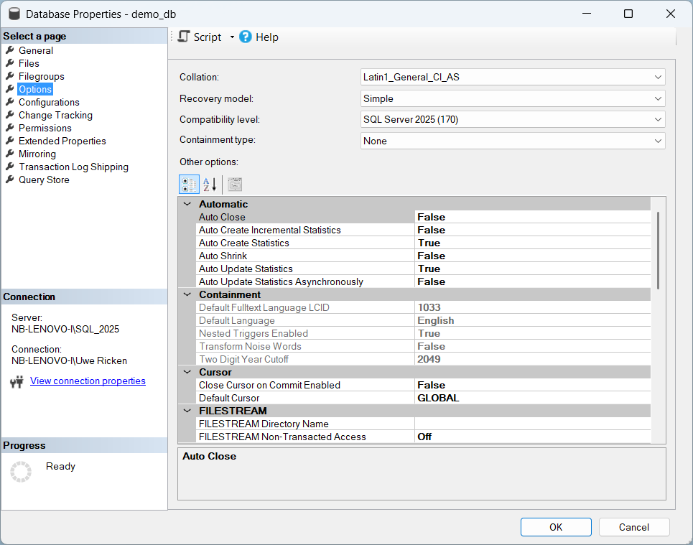
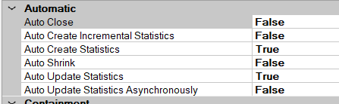
Database Settings
Auto Create Statistics
  SQL Server builds the statistics it needs the moment your queries demand them.
Auto Update Statistics
  Keeps statistics fresh so the optimizer doesn’t make decisions based on yesterday’s data.
Auto Update Statistics Asynchron…
  Refreshes stale stats in the background so your queries don’t have to wait for them.

Slide 14
When are Statistics created?
Automatic Creation
  Database Option “Auto create Statistics” must be ON
Index Creation
  Every Index automatically creates a corresponding statistics object on the key column(s).
Manual Creation
  Used for filtered stats, multi-column stats or precision control
CREATE NONCLUSTERED INDEX nix_customers_c_nationkey
ON dbo.customers (c_nationkey);
CREATE STATISTICS stats_orders_o_orderpriority
ON dbo.orders (o_orderpriority);

Slide 15
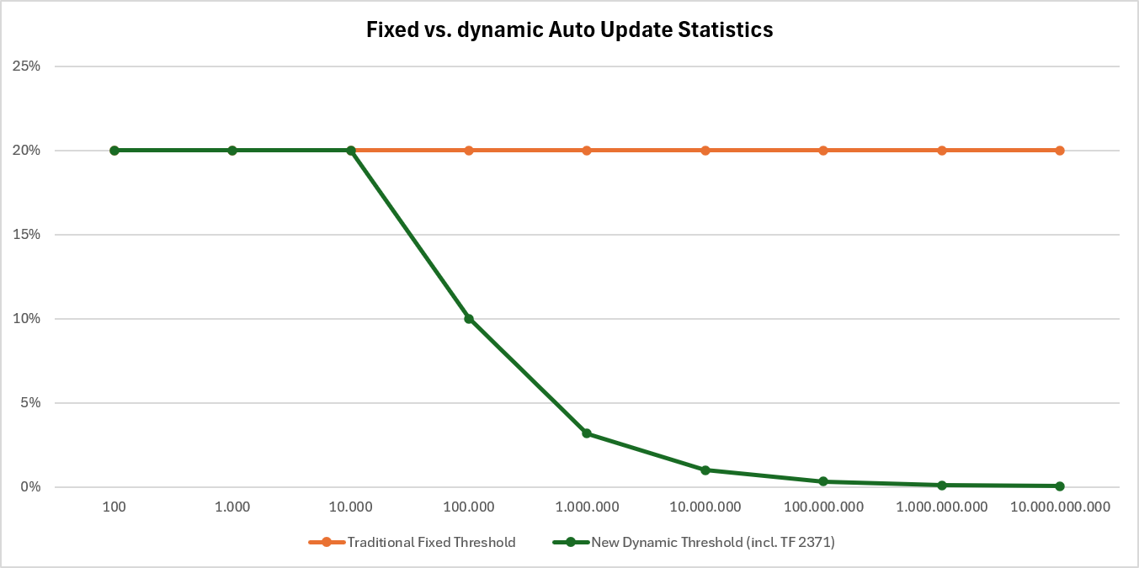
When are Statistics updated?
Automatic Updates
  Triggered when enough rows have changed
  Threshold depends on Compatibility Level
Manual Updates
  Used when precision or deterministic behavior is required.

Slide 16
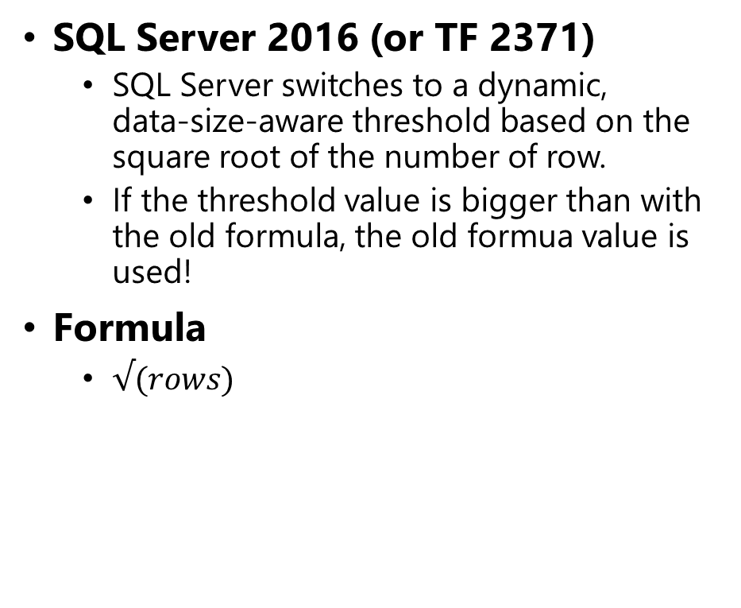
Algorithm for AUTO_UPDATE_STATISTICS:
Before SQL Server 2016
  If the cardinality of a table is between 7 and 500 the statistics will be updated after 500 modifications.
  If the table has more than 500 rows the statistics will be updated when 500 records + 20% have been modified.
Formula
  rows * 20%
SQL Server 2016 (or TF 2371)
  SQL Server switches to a dynamic, data‑size‑aware threshold based on the square root of the number of row.
  If the threshold value is bigger than with the old formula, the old formua value is used!
Formula
  $√(rows)$

Slide 17
Maintenance of statistics
Statistics have to be updated regulary for efficient execution plans
Statistics will be recreated / updated by the following conditions:
  Creation / Rebuild of an index
  Execution of sp_updatestats
  Execution of UPDATE STATISTICS
  Automatic updated
Recommendation
  http://ola.hallengren.com

Slide 18

https://github.com/db-berater/...

